Slide 1
Battle of cities for pizza

Slide 2
I have taken five cities namely NY , Chicago , Jersey city , San Francisco and Boston
Here I am going to look for the most dense city with pizza place so that tourist can decide where they want to search their Hotels
Here , I m going to use Foursquare API to look for the venues near to these 5 cities
Then I will be going to show u individual maps for these cities so that one can easily find which city is most dense

Slide 3
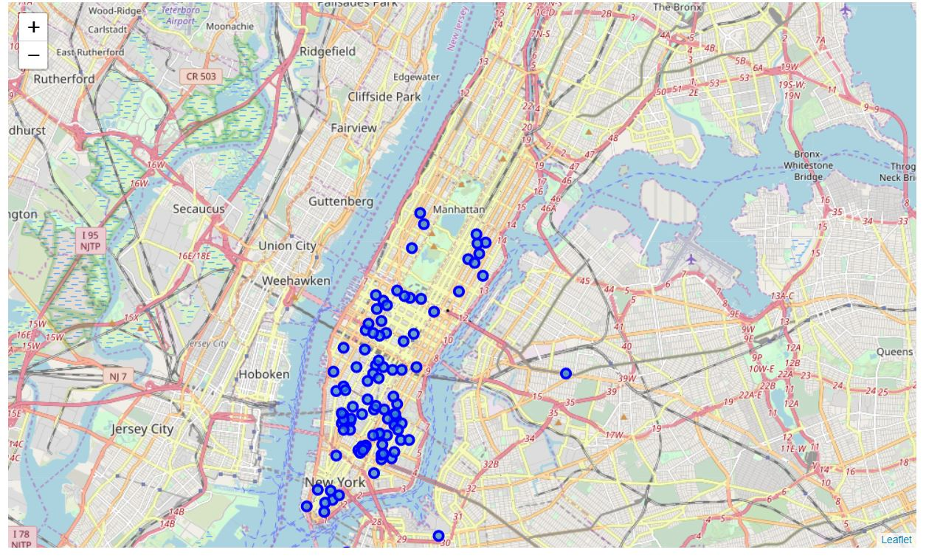
FOR NY

Slide 4
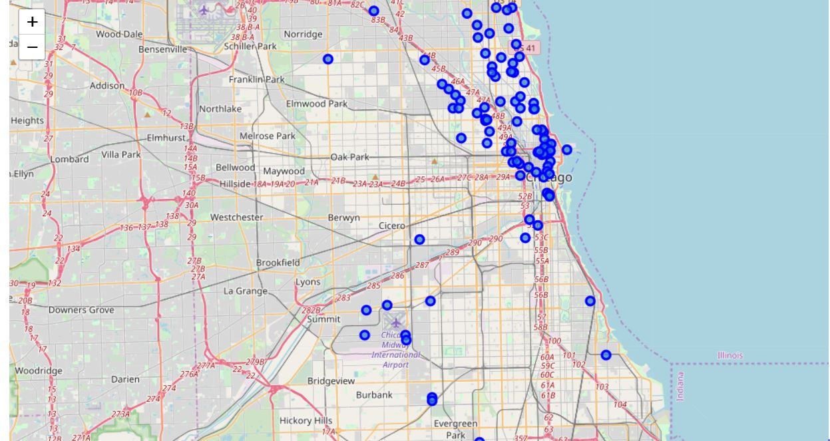
FOR CHICAGO

Slide 5
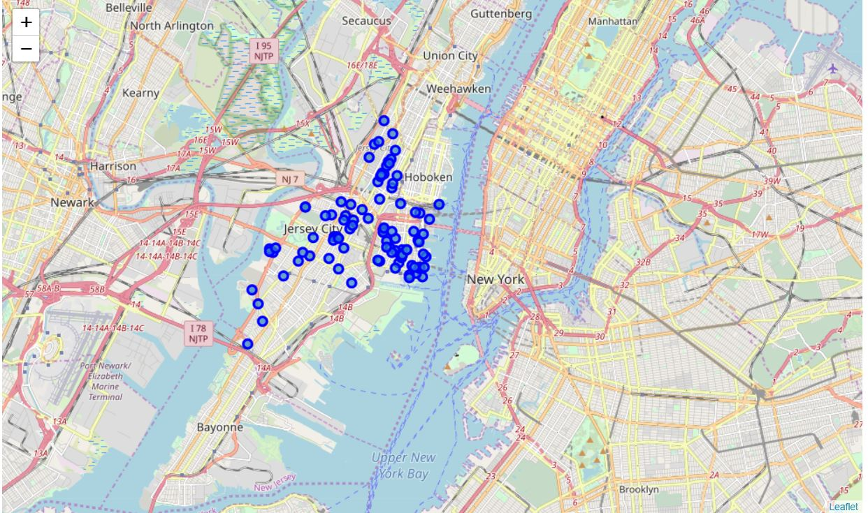
FOR JERSEY_CITY

Slide 6
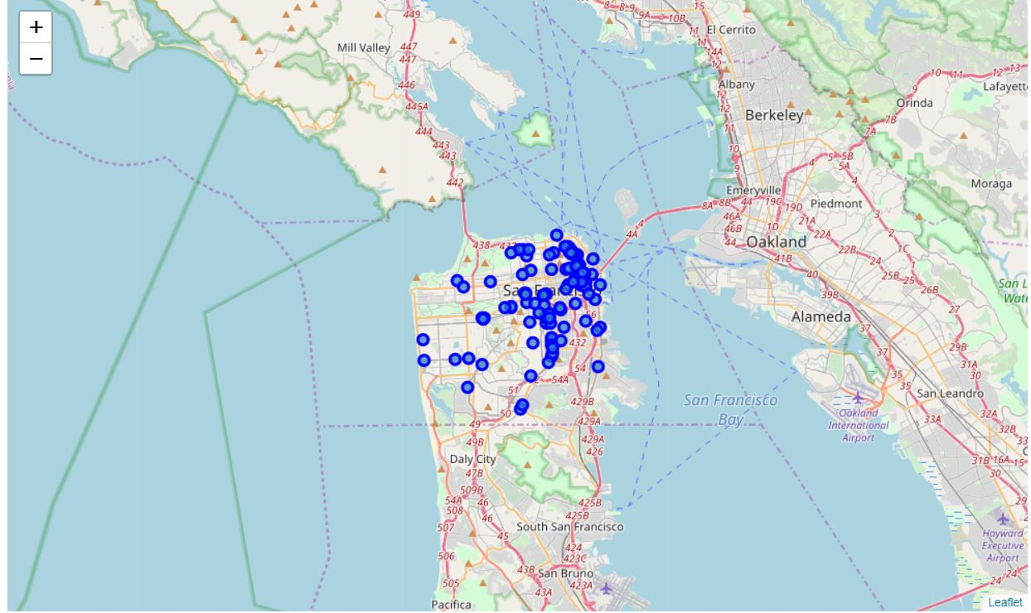
FOR SAN_fRANCISCO

Slide 7
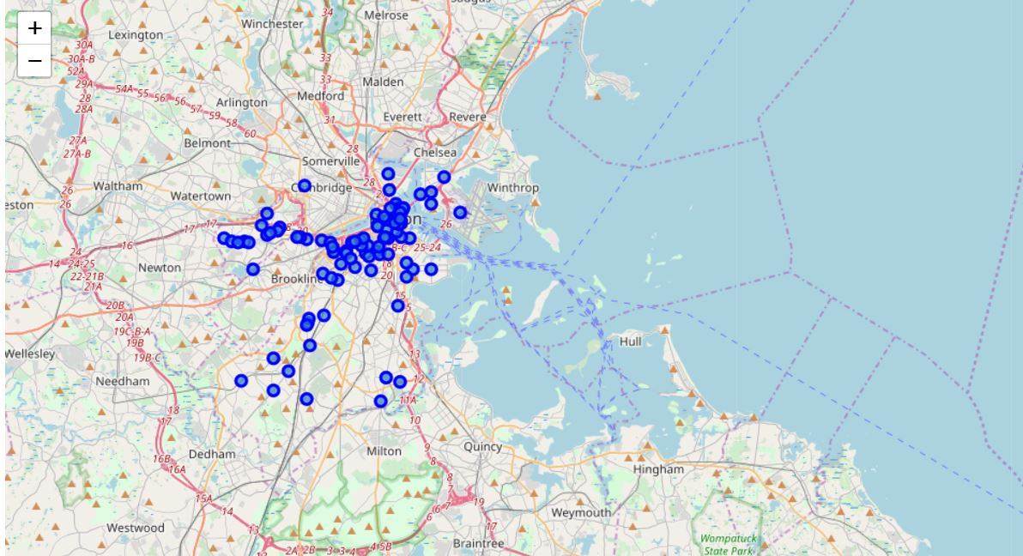
FOR BOSTON

Slide 8
Now , we are going to take the mean of all the pizza places for every city to determine which neighbourhood can be most nearer to all the pizza venues
I ‘ll be attaching mean map graph for cities namely NY ,CHICAGO,JERSEY_CITY and SAN_Francisco respectively.

Slide 9
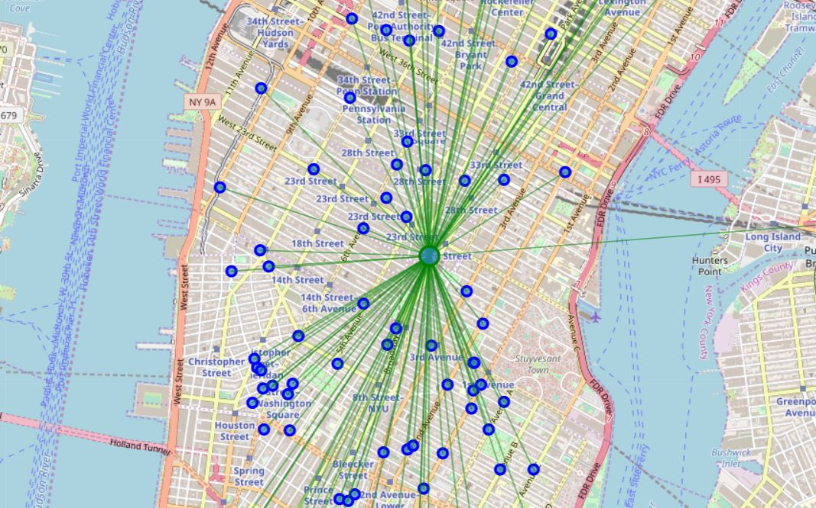

Slide 10
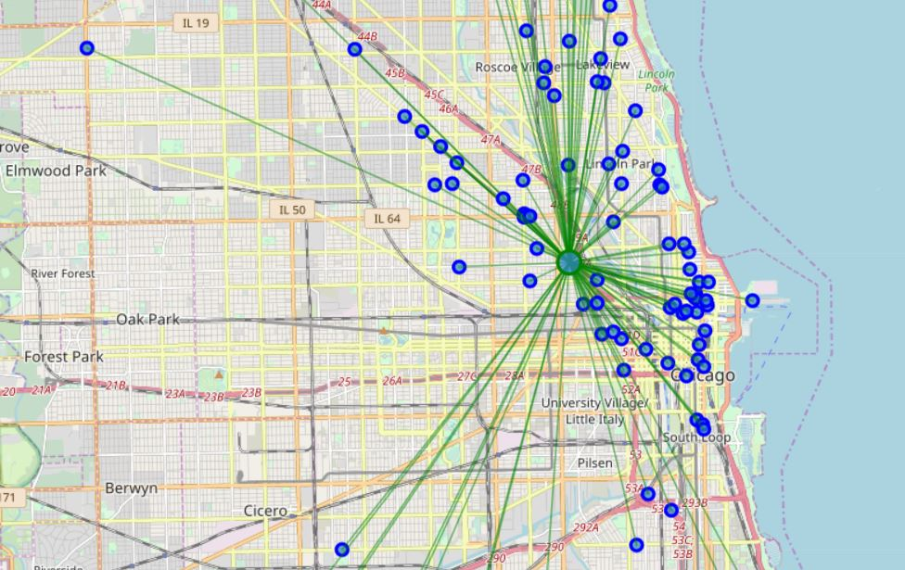

Slide 11
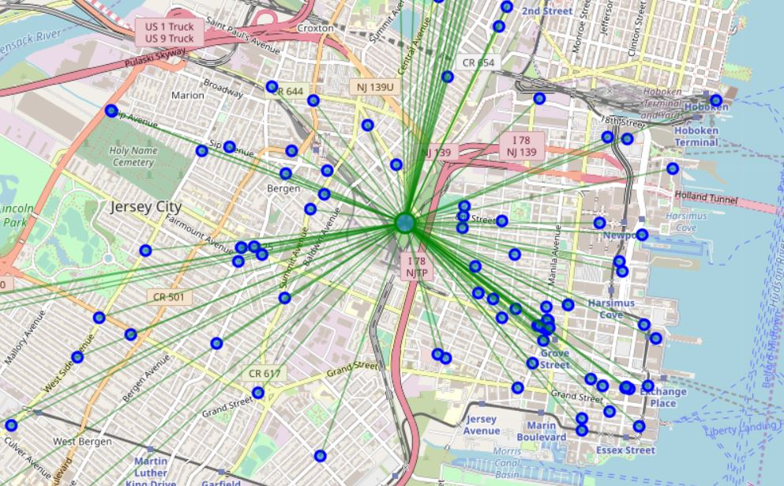

Slide 12
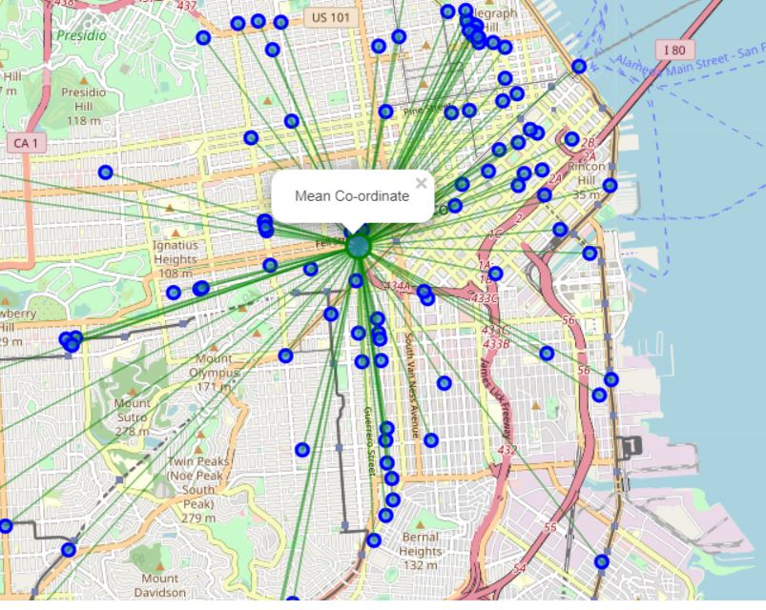

Slide 13
CONCLUSION
By looking at the maps we can easily say that NY has most dense pizza places
But one important point to note that distance b/w NY city and Jersey city is not much and also jersey city is also good populated eith pizza places
So , we can assume that Jersey city can also be good place for tourist to check their hotel

